Slide 1
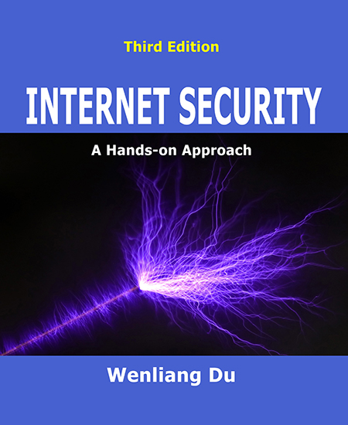
NT101-Network Security
Week 14: Network Defence
Ngoc-Tu Nguyen, PhD
tunn@uit.edu.vn

Slide 2
Outline
Network secure protocols
Fundamental goals
Authentication: network nodes (hosts), application API (apps);
Key agreemen;
Cryptographic algorithm negotiation (ciphers, MAC)
Some secure protocols: SSH, SSL/TLS, IPSec,VPN;
Network traffic mornitor and analysis
Firewall;
IDS/NIDS;
AMS
Honeynet;
Notes:
Cipher=a secret system of writing;

Slide 3










TCP/IP Network Model
application
transport
network
link
physical
H_{a}
M
H_{a}
M
application
transport
network
link
physical
message
M₁ | M₂ | … | M_{n}
M₂ | M₁ | … | M_{n}
segment
H_{t}
M_{i}
…
H_{t} M_{i}
datagram
frame
H_{n} H_{t}
H_{n} | H_{t} | M_{i}
M_{i}
H_{l} | H_{n} | H_{t} | M_{i}
_{Hl} | _{Hn} | _{Ht} | _{Mi}
source
destination

Slide 4
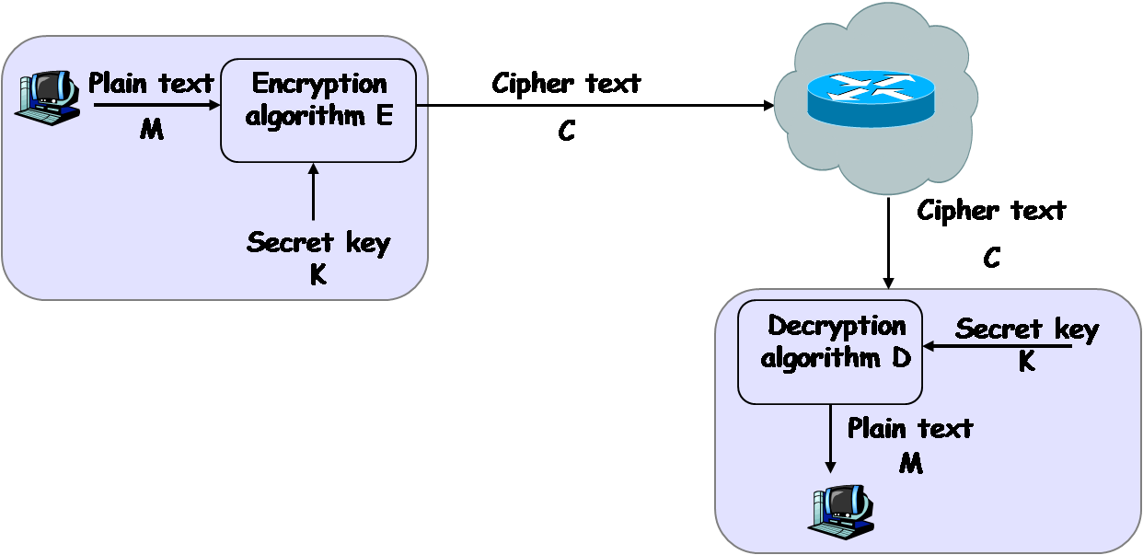
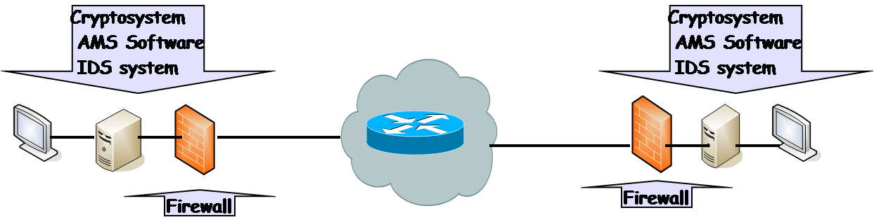
Basic Security Model
Public intermediate devices
Cryptosystem layer
Authentication
Key agreement
Cryptographic algorithm negotiation (ciphers, MAC)
Enterprise network
Network Traffic Monitoring and Analysis
IDS/NIDS, AMS
Firewall
Honeynet

Slide 5
Network secure protocols
Authentication
Public key (digital certificate) approach
Prior secret-shared approach
Key agreement
Diffie-hellman key exchange
Cryptographic algorithm negotiation (ciphers, MAC)
Some secure protocols
Chosent layer to implement (application to link layer)
SSH, SSL/TLS, IPSec,VPN;
Notes:
Cipher=a secret system of writing;

Slide 6


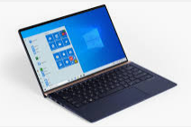

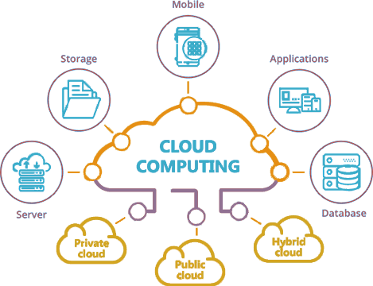
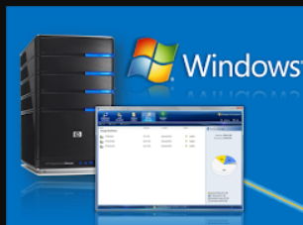
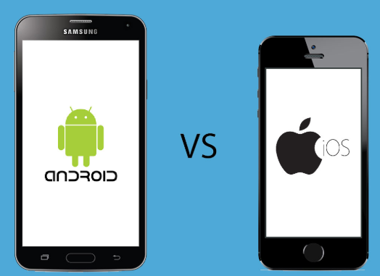


Network secure protocols
Mutual authentication?
(A)
(B)
(A)
(B)
(3)
Identification information?
Exchange authentication factors?
Verification?
Key agreement machanism?
User
(A)/ (B)
User
Solutions?
(A) Certificates (PKI)
(B) Pre-shared secrets
Iot/Edge/fog/cloud network
(1)
Local system
(4)
(B)
(B)
(A) /
(B)
Remote
server
(5)
AI/ML
User
(2)
(A) / (B) /
(B)
Attestation services
(A) /
(B)
Notes:
authentication factors= Các yếu

Slide 7
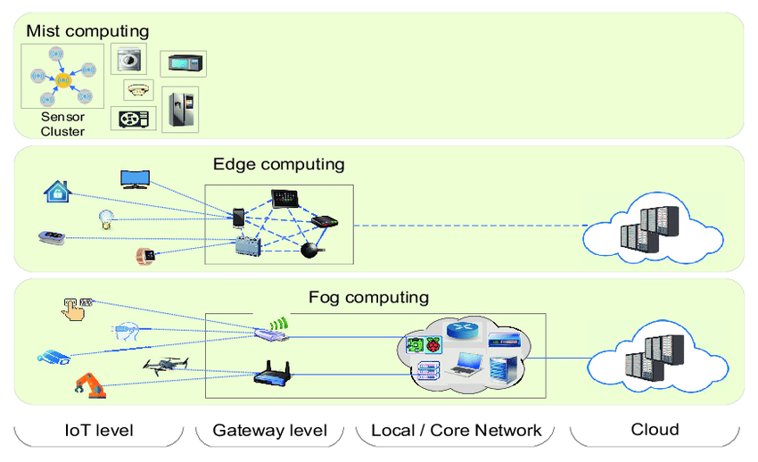
Authenticate server/resources
Users authenticate server/ resources
?
?
User space
?
?
?
?
Notes:
authentication factors= Các yếu

Slide 8
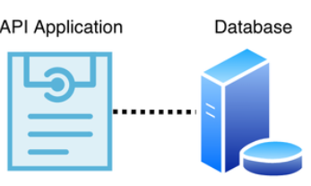

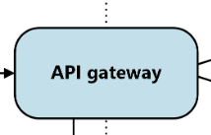


Network secure protocols
Network authentication API
Client applications
Static strings
Dynamic tokens
User-delegated token
Attribute-Based Access Control
https://en.wikipedia.org/wiki/Web_API_security
Notes:
authentication factors= Các yếu

Slide 9
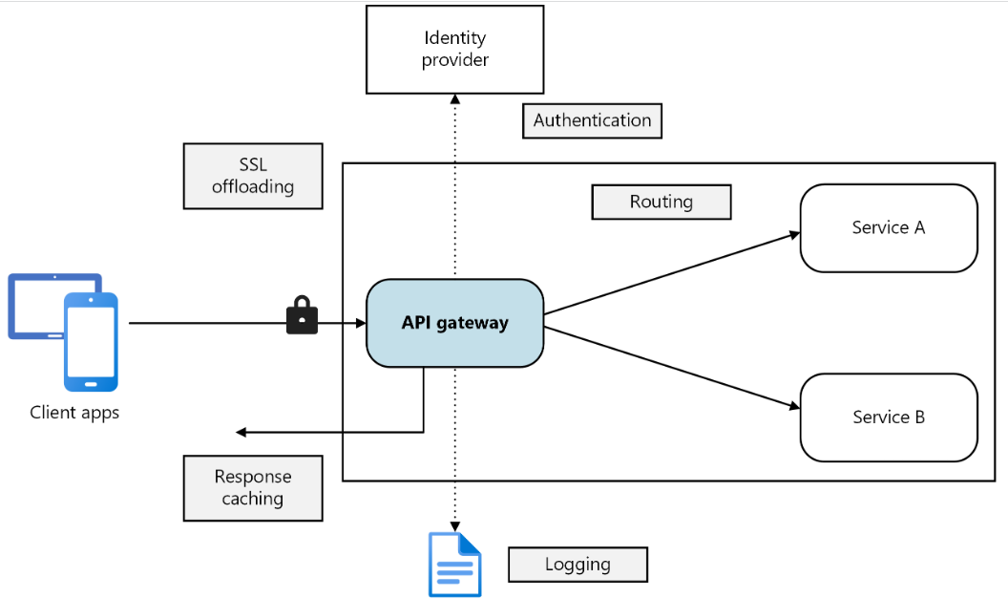
Network secure protocols
https://learn.microsoft.com/en-us/azure/architecture/microservices/design/gateway
Notes:
authentication factors= Các yếu

Slide 10
Authentication
RFC 4949 (Internet Security Glossary, Version 2):
Authentication= “The process of verifying a claim that a system entity or system resource has a certain attribute value”
Authentication process =
Identification information
Verification
A
B
A authenticate B
B authenticate A
Mutual authentication:
Notes:
The process of verifying = Quá trình xác minh
Authentication= xác thực

Slide 11
Authentication
Authentication factors
Knowledge (something the user/node knows)
ID, Password, PIN, answers to prearranged questions
Possession (something the user/node has)
Smartcard, electronic keycard, physical key, user’s devices, digital certificates, …
Inherence (some physical characteristic of the user/devices)
Fingerprint, retina, face, voice pattern, handwriting, typing rhythm, PUFs,…
Notes:
authentication factors= Các yếu

Slide 12
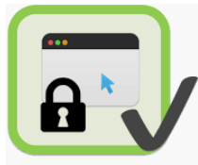
Authenticate server/resources
Users authenticate server/ resources
Client-server
Remote
server
?
end-to-end
?
hop-to-hop
Notes:
authentication factors= Các yếu

Slide 13

Authenticate server/resources
Degital certificate-based
authentication
CERTIFICATE
Digital certificate
User
Servers
$certificate=(\{user, public key,…\},s)$
Verify signature $s$
User authenticate sever
Know server’s puclic key

Slide 14
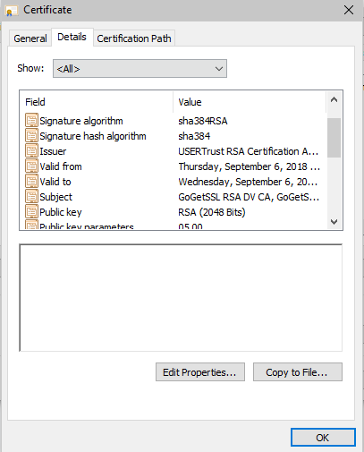
Authenticate server/resources
Certificates-based authentication
Remote server
Certificate
Public key/ Secret key
Exchange authentication/
key agreement data
Combine:
Public key
Server Identity (IP, name,…)
Signature
Trusted CA
PKI

Slide 15
Authenticate server/resources
CA
CA
CA
CA
Directory
Services
CA
RA
CA
CA
CA
RA
RA
Internet
RA
Required
Server certificate
Root CA certificate (CA Public key)
RA
RA
Internet
LRA
LRA
openssl s_client -connect facebook.com:443 -showcerts
https://www.openssl.org/docs/man1.0.2/man1/openssl-s_client.html

Slide 16
Authenticate server/resources
Example: Check facebook.com certificate using openssl library
Degital certificate-based
authentication
Show all cert chains
openssl s_client -connect facebook.com:443 -showcerts
view server cert
Digital certificate
echo | openssl s_client -servername www.facebook.com -connect www.facebook.com:443 2>1 | openssl x509 -out facebook.cer -text
User
Servers
download server cert
Facebook.com
echo | openssl s_client -servername www.facebook.com -connect www.facebook.com:443 2>1 | openssl x509 -out facebook.cer
dump server cert
openssl x509 -in facebook.cer -inform pem -text -noout

Slide 17
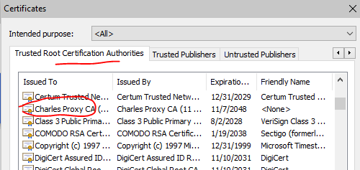
Authenticate server/resources
Limitation
Certificates-based authentication
Need PKI
Revocation?
Network Payload?
Trusted CA?
Semi-Trusted
Zero-Trusted

Slide 18
Authenticate user/end-devices
Authentication factors
Knowledge (something the user/node knows)
ID, Password, PIN, answers to prearranged questions
Possession (something the user/node has)
Smartcard, electronic keycard, physical key, user’s devices, digital certificates, …
Inherence (some physical characteristic of the user/devices)
Fingerprint, retina, face, voice pattern, handwriting, typing rhythm, PUFs,…
Notes:
authentication factors= Các yếu

Slide 19





Authenticate user/end-devices
Request connection
?
$$SK_{S}$$
?
Remote server
User/devices
How the server authenticate the user/devices?
Password
OTP
Token
Biometric, device fingerprint
Smart card
….
Using pre-shared secrets
$sk_{shared}$
$store s{k′}_{shared}$
ex. $pw$
ex. $h(pw)$
Notes:
authentication factors= Các yếu

Slide 20

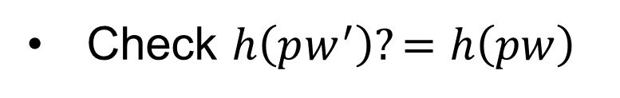
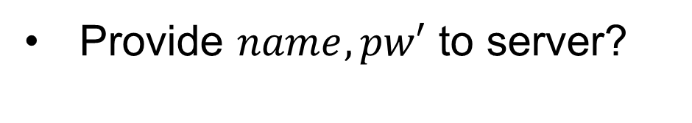

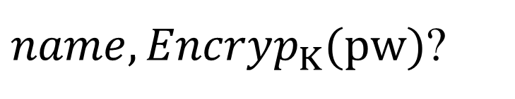

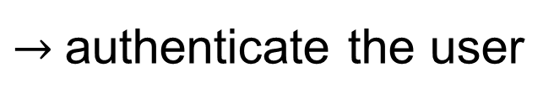
Authenticate user/end-devices
(1) Password-based Authentication
$store:name, h(pw)$
$name, pw$
Login
Provide $name, pw′$ to server?
Locate the row using name
$name, Encryp_{K}(pw)$?
Check $h\left(pw^{′}\right)?=$ $h\left(pw\right)$
$→$authenticate the user
Notes:
authentication factors= Các yếu

Slide 21
Authenticate user/end-devices
Password-based Vulnerabilities
Human-memorable password
Small space of possible passwords
(1) Dictionary attacks
(2) Verification table attacks
• • •
Offline Dictionary attacks
https://hashkiller.io/listmanager

Slide 22
Authenticate user/end-devices
(2) Multiple factor Authentication
Pre-shared secrets
Passwords
One factor
Biometric (variation)
Verification?
Secure storage?
Password, OTP
Biometric (user/device)
Smartcard
Hardware-assisted
Smartcard
Secure storage
Do some verification
algorithms
Multiple
factor
Hardware-assisted (TPM, TEE, ...)
Secure storage
Do some secure algorithms
One-to-One?
One-to-many?
Scale-up ability?

Slide 23

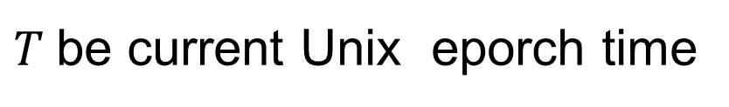


Authenticate user/end-devices
(2) Multiple factor Authentication: OTP. Biometric, ….
Example: OTP
$$secret K$$
$$secret K$$
$T$be current Unix eporch time
https://www.epochconverter.com/
$$TOTP value\left(K\right)= H\left(K, C_{T}\right) mod {10}^{d}$$
d digits integer

Slide 24
Network secure protocols
Authentication
Public key (digital certificate) approach
Prior secret-shared approach
Key agreement
Diffie-hellman key exchange
Cryptographic algorithm negotiation (ciphers, MAC)
Some secure protocols
Chosent layer to implement (application to link layer)
SSH, SSL/TLS, IPSec,VPN;
Notes:
Cipher=a secret system of writing;

Slide 25
Diffie-Hellman key exchange
Public info: p and g
p is a large prime number, g is a generator of Z_{p}*
Z_{p}*={1, 2 … p-1}; ∀a∈Z_{p}* ∃i such that a=g^{i} mod p
g^{x} mod p
Man-in-the-middle attack
Pick secret, random x
g^{y} mod p
Pick secret, random y
Compute k=(g^{y})^{x}=g^{xy} mod p
Compute k=(g^{x})^{y}=g^{xy} mod p

Slide 26
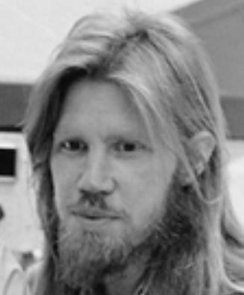
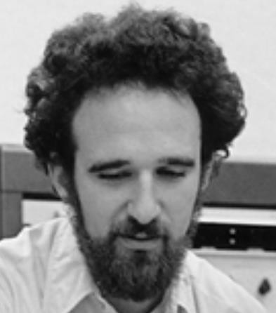


Diffie-Hellman key exchange
p = 1606938044258990275541962092341162602522202993782792835301301
𝑔 = 123456789
𝑔^{𝑎} mod p = 78467374529422653579754596319852702575499692980085777948593
𝑔^{𝑏} mod p=
560048104293218128667441021342483133802626271394299410128798
𝑎 =
685408003627063
761059275919665
781694368639459
527871881531452
𝑏 =
362059131912941
987637880257325
269696682836735
524942246807440
$${\left(g^{b}\right)}^{a}=$$
𝑔^{𝑎𝑏} mod p =437452857085801785219961443000845969831329749878767465041215
$${=\left(g^{a}\right)}^{b}$$

Slide 27




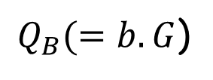

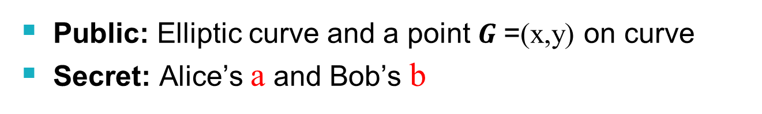

ECC Diffie-Hellman (ECDH)
Public: Elliptic curve and a point $G$=(x,y) on curve
Secret: Alice’s a and Bob’s b
$(a{, Q}_{A}=a.G)$
$(b{, Q}_{B}=b.G)$
$$Q_{A}(=a.G)$$
$Q_{B}(=b.G$)
$$K_{A}=a.Q_{B}=ab.G$$
$$K_{B}=b.Q_{A}=ba.G$$
$$K_{A}=K_{B}=ab G= \underset{ab=ba times}{\underbrace{G+G+…+G}}$$

Slide 28
Session Key agreement mechanism
Remote server
Authenticate
$$SK_{S}$$
$$Password,OTP, Biometric,..$$
Server Certificate
How to negotiate a session key?
Exchange data
Encryption?
Data integrity checking?
Key?
Notes:
authentication factors= Các yếu

Slide 29
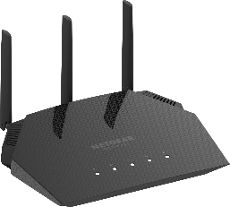
Session Key agreement mechanism
Remote server
?
Server Certificate
$$SK_{S}$$
$$verify (certificate, PK_{root})⇒PK_{S}$$
How authenticate each other if the server does not have certificate?
wifi access point
User
Using pre-shared secret
Password
Password
WEB, WPA2, WPA3 protocols
Notes:
authentication factors= Các yếu

Slide 30
Building Blocks for Network Security
Deployment network secure protocols
Encryption and authentication algorithms are building blocks of secure network protocols
Deploying cryptographic algorithms at different layers have different security effects
Where should we put the security protocol in the network architecture?

Slide 31

Deployment network secure protocols
How to establish secure protocol?
Authentication?
Key agreement
Chosen cipher, MAC for exchage data
AES-128-CBC, SHA256,
AES-256-GCM, SHA3-512, …
Notes:
Cipher=a secret system of writing;

Slide 32
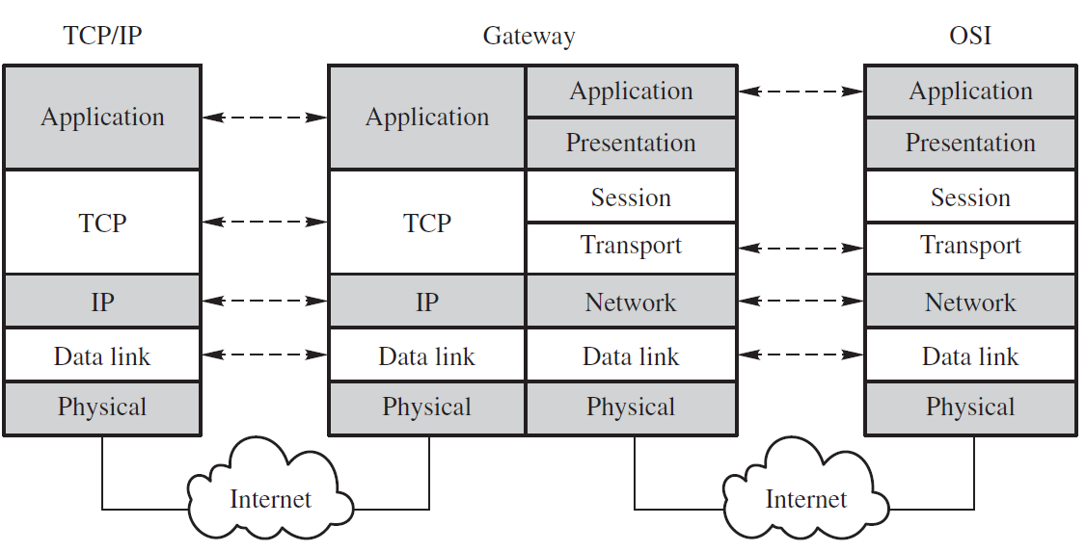
Where should we deploy the secure protocol?
Deployment network secure protocols

Slide 33
Deployment network secure protocols
Logical (Software)‏
Physical (Hardware)‏
Application
Web, Email
Transport Layer
TCP, UDP
Network Layer
IP
Data Link Layer
Ethernet, 802.11
Physical Layer

Slide 34
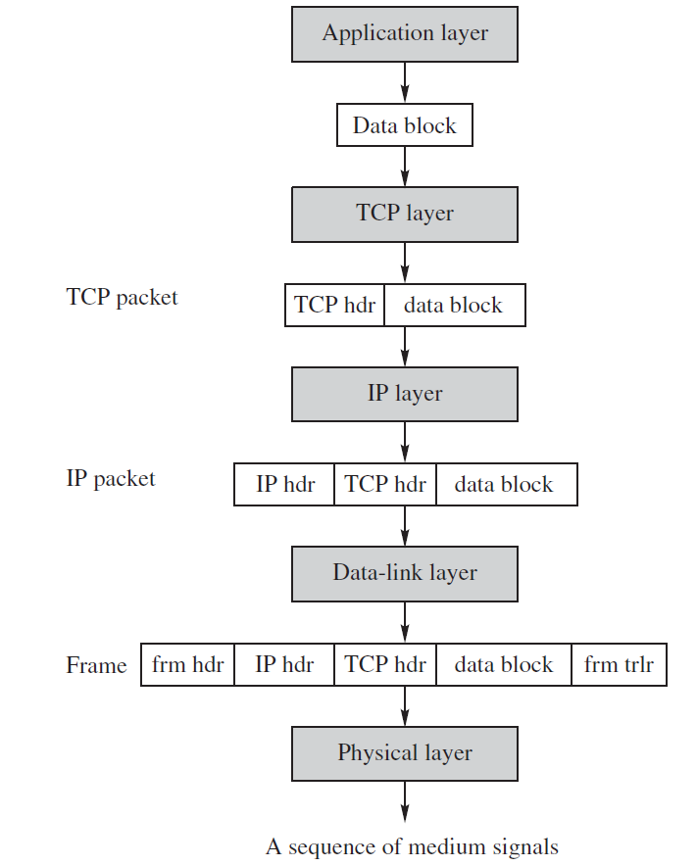
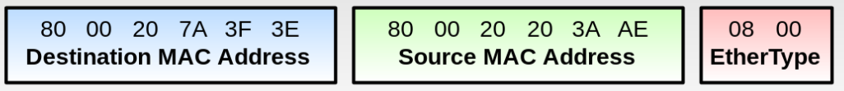

Deployment network secure protocols
PGP and S/MIME Email Security Protocols
SSL/TLS, SSH protocol
Ipsec, VPN protocols
WEB, WPA, WPA2, WPA 3 …
Notes:
frm trlr =redundancy check (CRC) trailer;

Slide 35
What Are the Pros and Cons?
Application Layer
Provides end-to-end security protection
Intermediate nodes need not to decrypt data or check for MAC, signature;
Attackers may analyse traffic and modify headers
Transport Layer
Provides security protections for TCP packets
No need to modify any application programs
Attackers may analyse/attacks via IP, link headers

Slide 36
What Are the Pros and Cons?
Network Layer
Provides node-to-node security protection
Transport mode: Encrypt payload only
Tunnel mode: Encrypt both header & payload; need a gateway
No need to modify any application programs
Data-link Layer
Provides security protections for frames
No need to modify any application programs
Traffic analysis would not yield much info

Slide 37
SSH protocol
SSH Connection:
Sets up multiple channels for different applications in a single SSH connection
SSH User Authentication:
Authenticate user to server
Using password or PKC
SSH Transport
Handles initial setup: server authentication, and key exchange
Set up encryption and compression algorithms
SSH Connection
SSH User Authentication
Application Layer
SSH Transport
TCP
IP
Data Link
Physical
SSH architecture

Slide 38
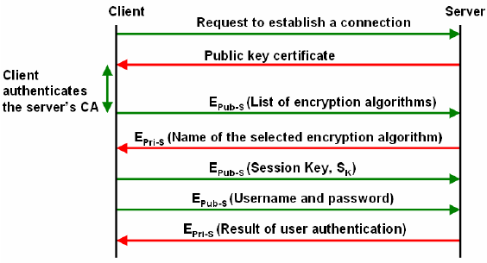
SSH protocol
Notes:
38

Slide 39
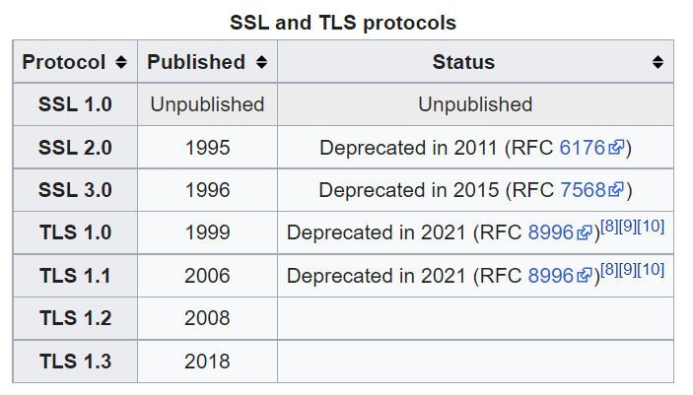
SSL/TLS
Secure Socket Layer Protocol (SSL)
Designed by Netscape in 1994
https://en.wikipedia.org/wiki/Transport_Layer_Security

Slide 40
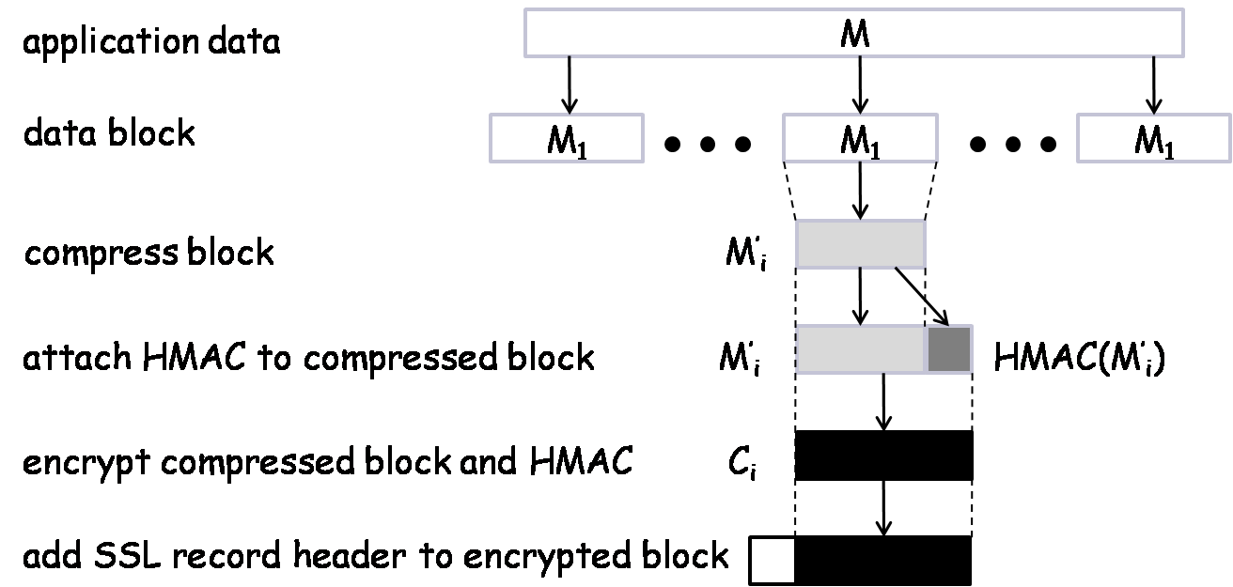
TLS Record Protocol Diagram
SSL record protocol

Slide 41
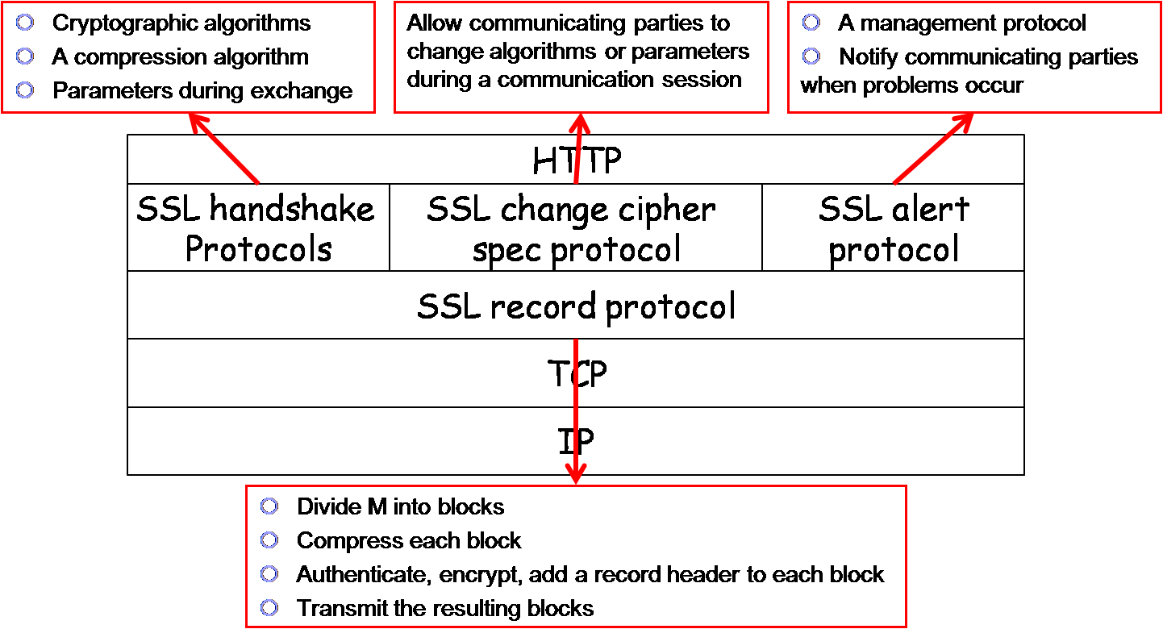
TSL Structure

Slide 42
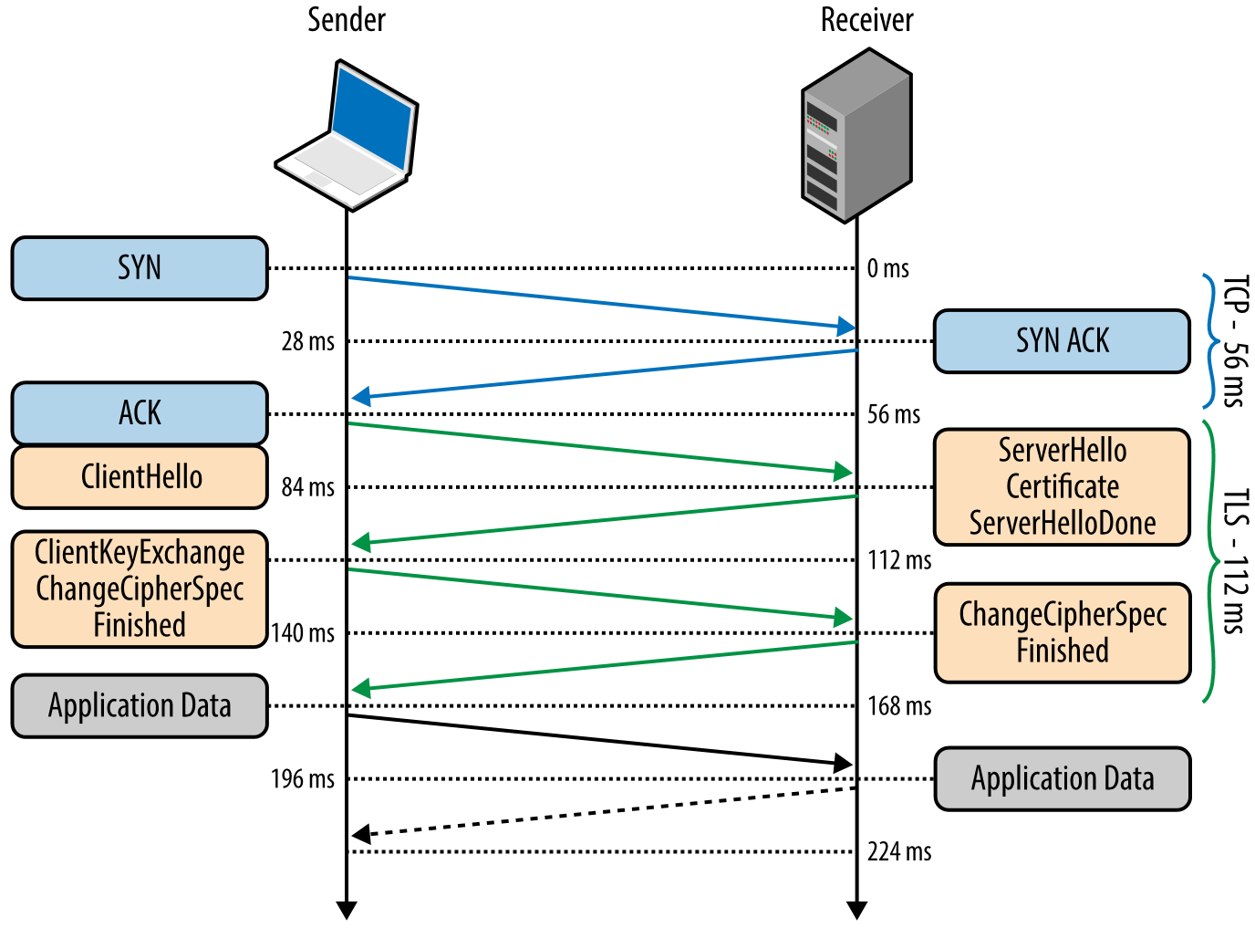
TSL protocol v 1.2
Authentication: digital certificate;
Key agreement(ex. ECDH)
Cryptographic algorithm negotiation (ciphers, MAC)

Slide 43
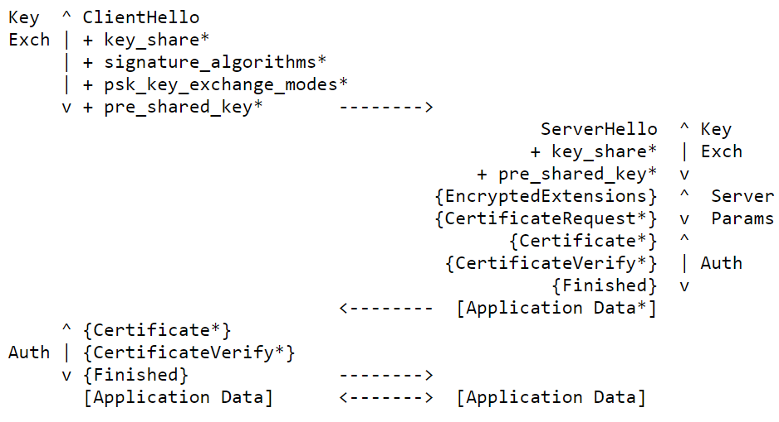
TSL protocol v 1.3
Client
Server
https://datatracker.ietf.org/doc/html/rfc8446

Slide 44
IPsec: Network-Layer Protocol
IPsec encrypts and/or authenticates IP packets
It consists of three protocols:
Authentication header (AH)
To authenticate the origin of the IP packet and ensure its integrity
To detect message replays using sliding window
Encapsulating security payload (ESP)
Encrypt and/or authenticate IP packets
Internet key exchange (IKE)
Establish secret keys for the sender and the receiver
Runs in one of two modes:
Transport Mode
Tunnel Mode (requires gateway)‏

Slide 45
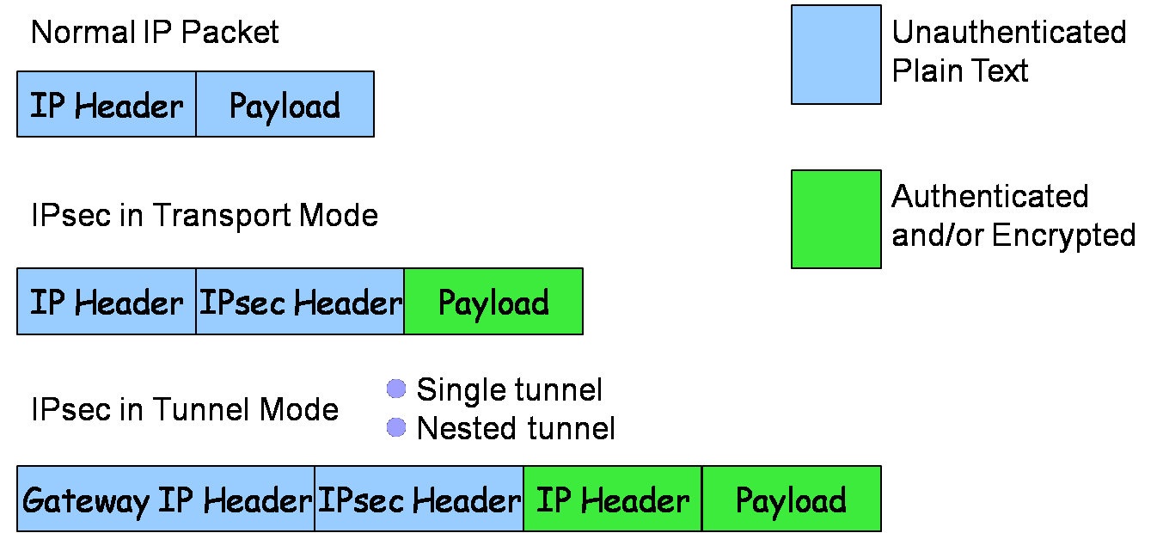
IPsec Packet Layout
H_{t}
M_{i}
segment

Slide 46
IPsec Transport Mode
Host-to-host (end-to-end) security:
IPsec processing performed at endpoints of secure channel.
Endpoint hosts must be IPsec-aware.
Header
Payload
Header
Payload
IP datagram
network
IP datagram

Slide 47
IPsec Tunnel Mode
Header
Payload
Header
Payload
Inner IP datagram
Inner IP datagram
Security
Gateway
network
Security
Gateway
Outer
Header
Header
Payload
Outer
Header
Header
Payload

Slide 48
Remote Host to Internal Server
Remote host has Internet access to gateway, then gains access to server behind gateway.
Traffic to server protected in inner tunnel.
Outer tunnel protects inner traffic over Internet.
Outer Tunnel
Inner tunnel
Internet
Local network
Security
Gateway
remote
host
server

Slide 49
IPsec Security Associations
Alice
Bob
SA
If Alice wants to establish an IPsec connection with Bob, the two parties must first negotiate a set of keys and algorithms
The concept of security association (SA) is a mechanism for this purpose
An SA is formed between an initiator and a responder, and lasts for one session
An SA is for encryption or authentication, but not both.
If a connection needs both, it must create two SAs, one for encryption and one for authentication

Slide 50
SA Components
Three parameters:
Security parameters index (SPI)
IP destination address
Security protocol identifier
Security Association Database (SAD)
Stores active SAs used by the local machine
Security Policy Database (SPD)
A set of rules to select packets for encryption / authentication
SA Selectors (SAS)
A set of rules specifying which SA(s) to use for which packets

Slide 51
IPsec Header
IPsec Header
Authentication Header (AH)‏
Encapsulated Security Payload (ESP)‏
Authentication and Encryption use separate SAs
Data confidentiality
Data origin authentication,
data integrity checking, and
replay protection (optional)

Slide 52
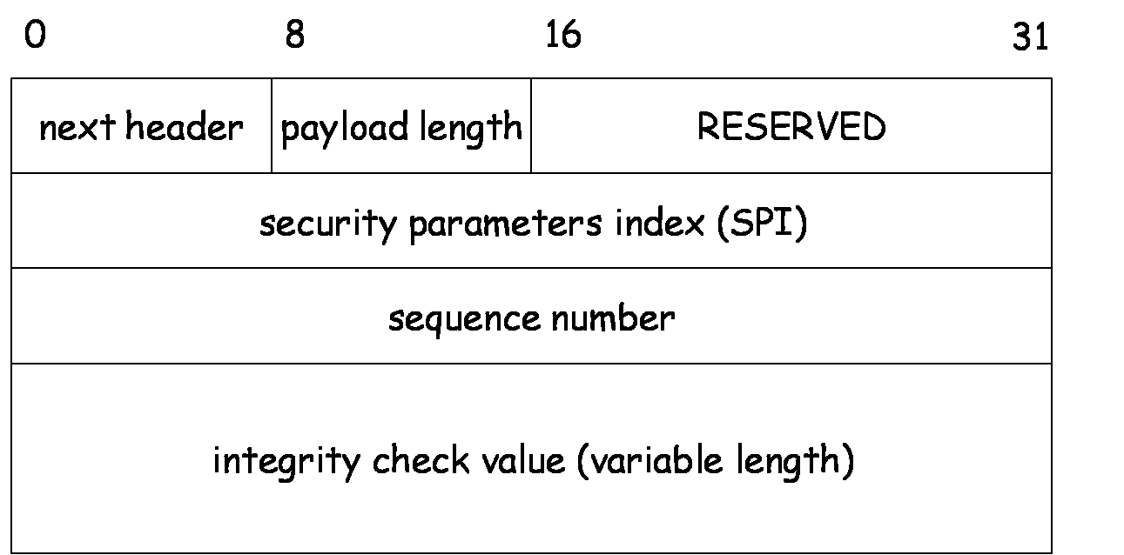
Authentication Header

Slide 53
Resist Message Replay Attack
Sequence number is used with a sliding window to thwart message replay attacks
A
B
C
Given an incoming packet with sequence # s, either
s in A – It's too old, and can be discarded
s in B – It's in the window. Check if it's been seen before
s in C – Shift the window and act like case B

Slide 54
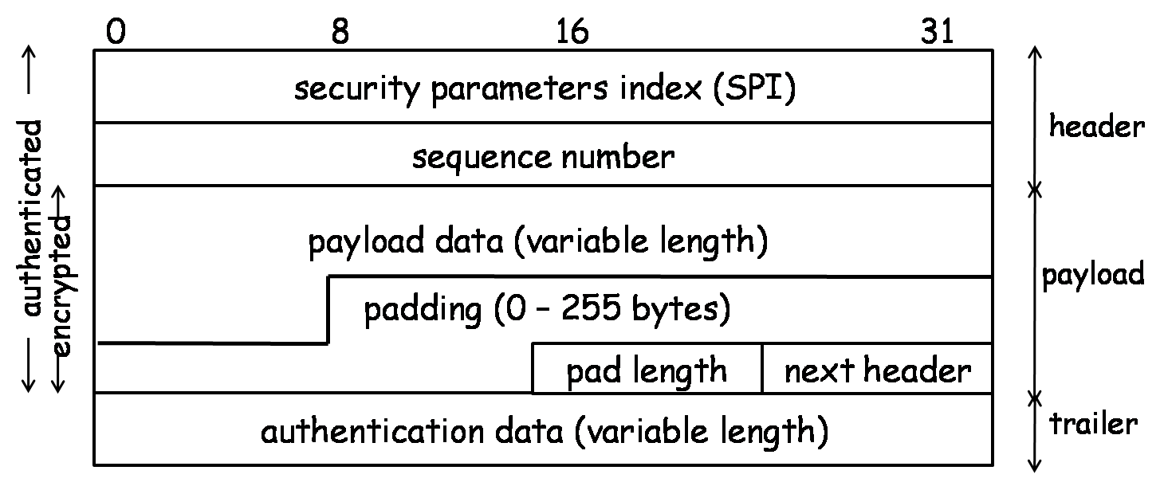
Encapsulated Security Payload

Slide 55
ESP Protocol – Transport & Tunnel
ESP in transport mode:
Original
IP header
ESP hdr
SPI, seqno
Payload
(eg TCP, UDP, ICMP)
ESP
trlr
ESP
auth
MAC scope
ESP in tunnel mode:
Encryption scope
Outer
IP header
ESP hdr
SPI, seqno
Inner
IP header
Payload
(eg TCP, UDP, ICMP)
ESP
trlr
ESP
auth
MAC scope
Encryption scope

Slide 56
Key Determination and Distribution
Oakley key determination protocol (KDP)
Diffie-Hellman Key Exchange + authentication & cookies
Authentication helps resist man-in-the-middle attacks
Cookies help resist clogging attacks
Nonce helps resist message replay attacks

Slide 57
Clogging Attacks
A form of denial of service attacks
Attacker sends a large number of public key Y_{i} in crafted IP packets, forcing the victim’s computer to compute secret keys K_{i} = Y_{i}^{X} mod p over and over again
Diffie-Hellman is computationally intensive because of modular exponentiations
Cookies help
Before doing computation, recipient sends a cookie (a random number) back to source and waits for a confirmation including that cookie
This prevents attackers from making DH requests using crafted packets with crafted source addresses

Slide 58
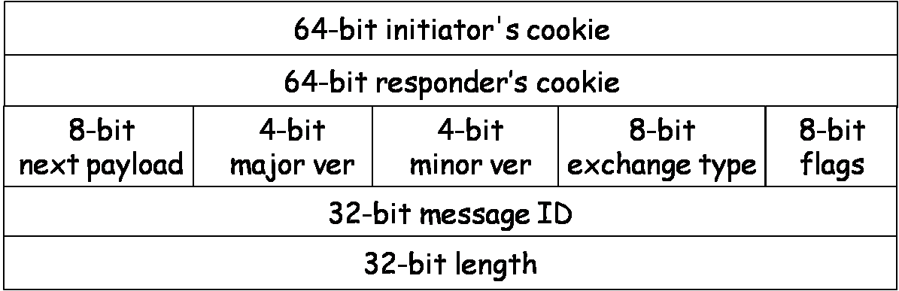
ISAKMP
ISAKMP: Internet Security Association and Key Management Protocol
Specifies key exchange formats
Each type of payload has the same form of a payload header
ISAKMP header

Slide 59
ISAKMP Payload Types
SA: for establishing a security association
Proposal: for negotiating an SA
Transform: for specifying encryption and authentication algorithms
Key-exchange: for specifying a key-exchange algorithm
Identification: for carrying info and identifying peers
Certificate-request: for requesting a public-key certificate
Certificate: contain a public-key certificate
Hash: contain the hash value of a hash function
Signature: contain the output of a digital signature function
Nonce: contain a nonce
Notification: notify the status of the other types of payloads
Delete: notify the receiver that the sender has deleted an SA or SAs
8-bit
Next payload
8-bit
Reserved
16-bit
Payload length

Slide 60
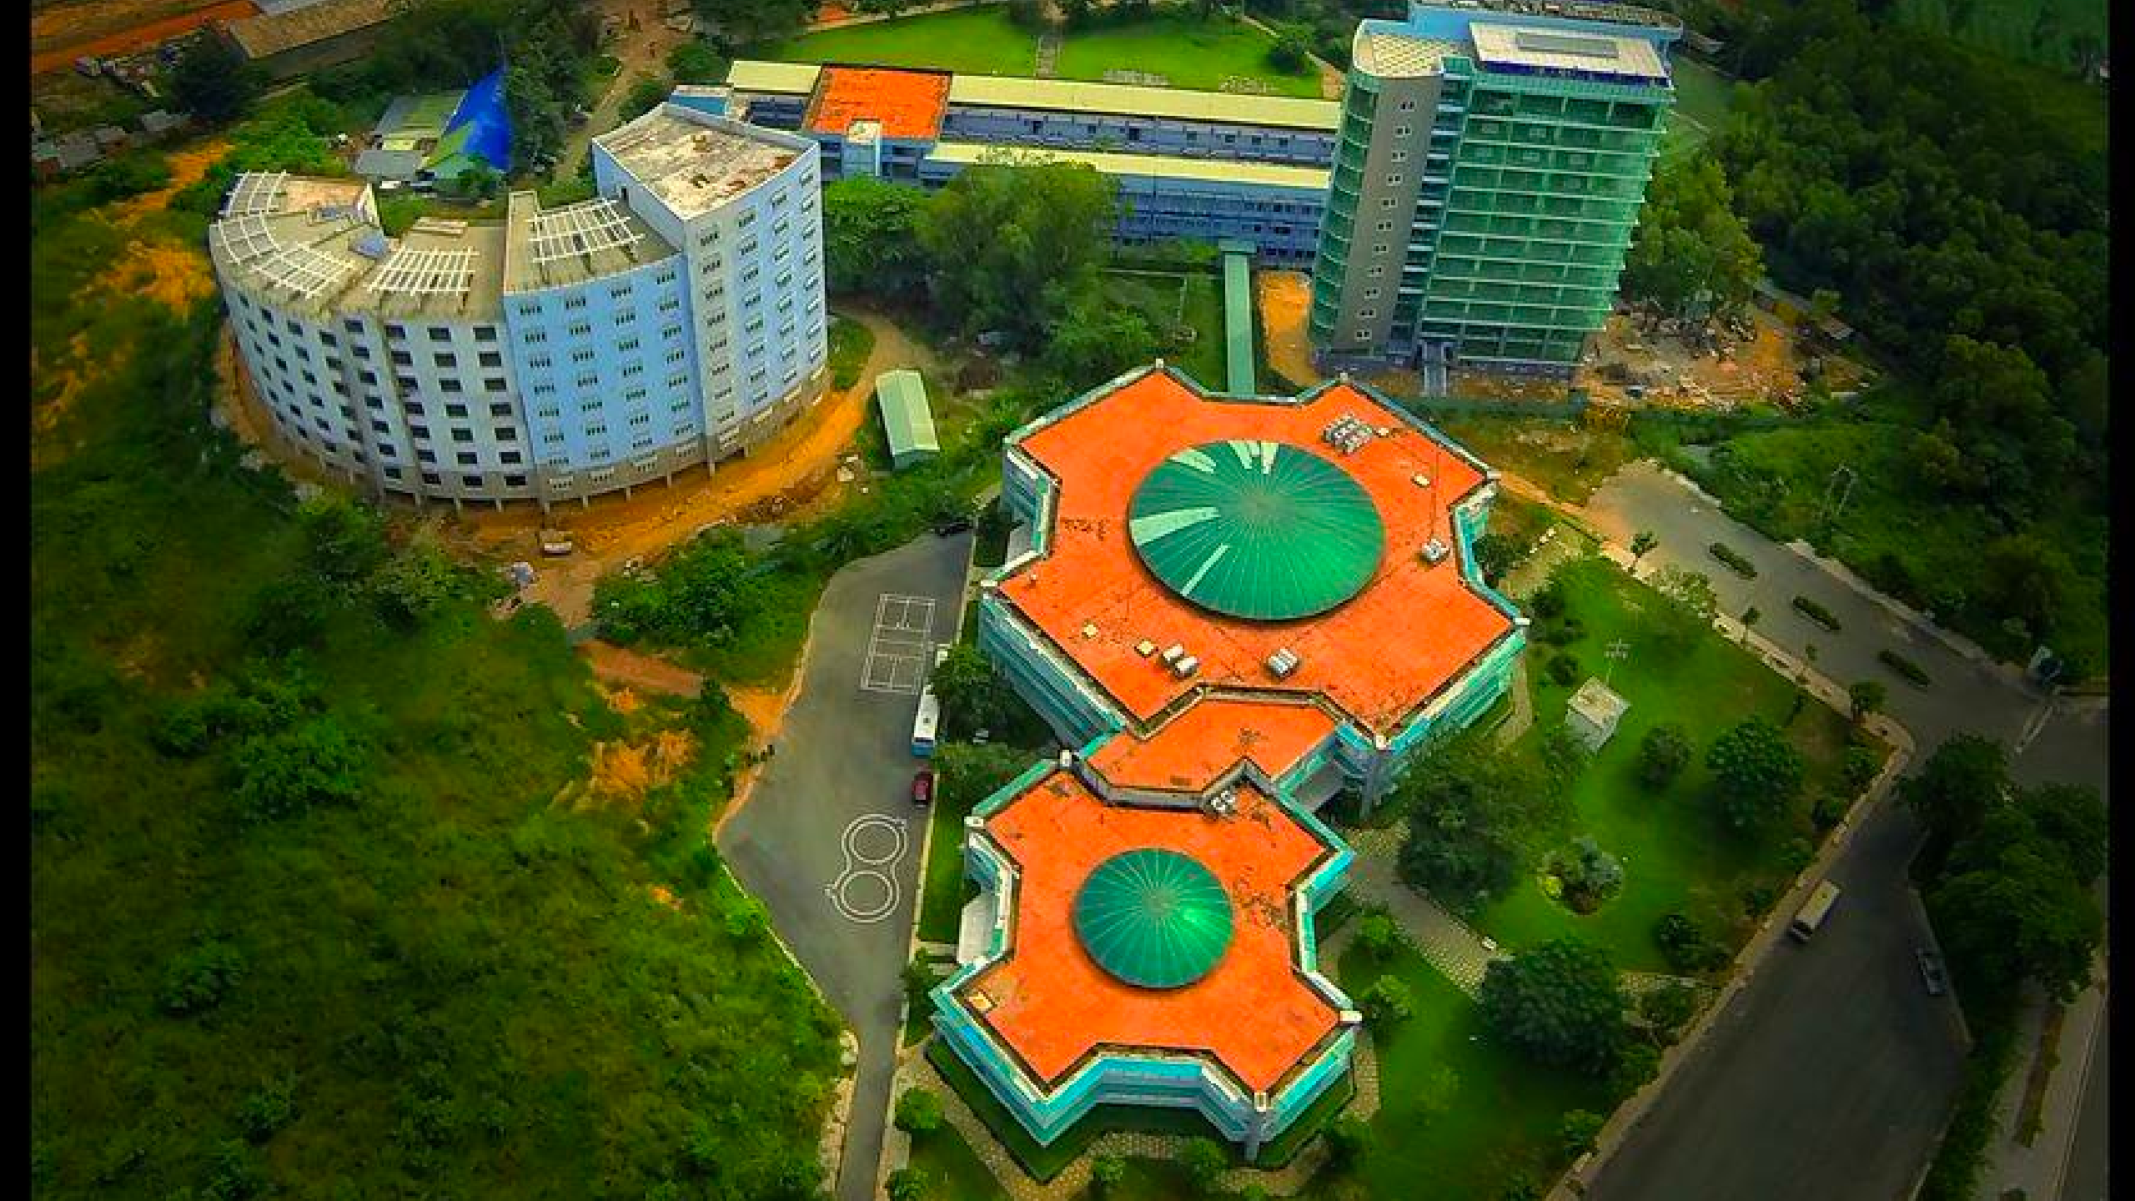
Today end,
Congrats!

